Slide 1
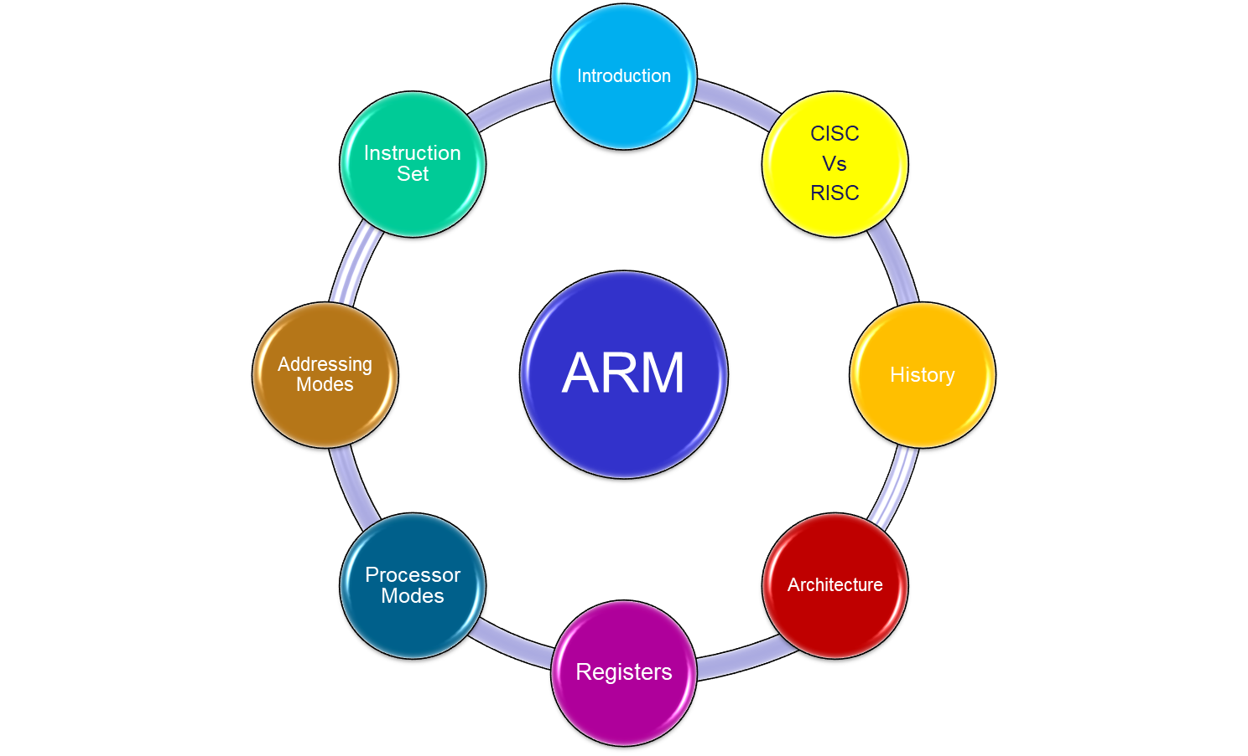
Agenda
What is ARM? Where to start?
Notes:
Programmers Model
The structure of the ARM architecture
How it has developed
Register set, modes and exceptions
The endian issue

Slide 2
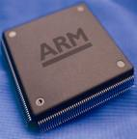
Introduction
ARM Processors
What is it?
Family of 32/64-bit microcontroller / processors
Who makes it?
ARM has changed their name several times:
Acorn RISC Machines (1985)
Advanced RISC Machines (1990)
ARM Holdings (1998)
ARM applications?
Mid-high level complexity hand-held consumer electronics
PDA’s (1980’s)
Cell phones (1990’s)
Handheld game devices (2000’s)

Slide 3

Example Consumer Products

Slide 4
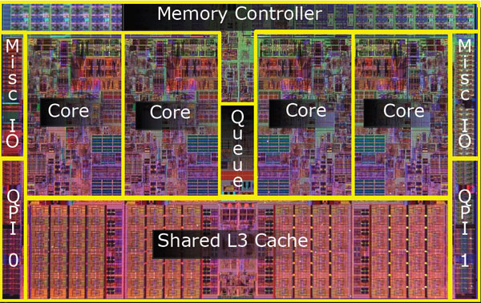
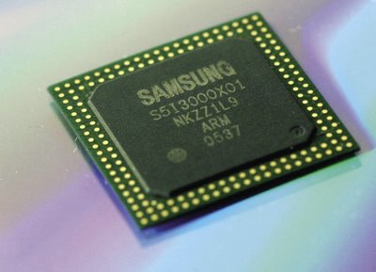

ARM is Processor design, not a chip
Core design
Chip design & fabrication
ARM licenses core designs to other companies
OEMs can customize chips
ARM provides compilers, development tools and debugging tools for chip development and product development
Nintendo DS

Slide 5
CISC vs RISC
CISC | RISC
Variable size instructions | Fixed size instructions (32-bit)
Large instruction sets | Reduced instruction sets
Complex instruction sets | Simple instruction sets
Complex decoding | Simple decoding
Multiple fetch cycles | One fetch cycles
Multiple execute cycles | One execute cycles
Limited registers | Many registers
Operations performed on registers and memory | Operations performed mainly on registers
Many addressing modes | Few addressing modes
Poor pipelining | Excellent pipelining
Slower due to flexible | Faster due to rigid nature
Mainly used in Microprocessor | Mainly used in Microcontroller and SoCs

Slide 6
History of ARM
ARM (Acorn RISC Machine) started as a new, powerful, CPU design for the replacement of the 8-bit 6502 in Acorn Computers (Cambridge, UK, 1985)
First models had only a 26-bit program counter, limiting the memory space to 64 MB (not too much by today standards, but a lot at that time).
1990 spin-off: ARM renamed Advanced RISC Machines
ARM now focuses on Embedded CPU cores
  IP licensing: Almost every silicon manufacturer sells some microcontroller with an ARM core. Some even compete with their own designs.
  Processing power with low current consumption
    Good MIPS/Watt figure
    Ideal for portable devices
  Compact memories: 16-bit opcodes (Thumb)
New cores with added features
  Harvard architecture (ARM9, ARM11, Cortex)
  Floating point arithmetic
  Vector computing (VFP, NEON)
  Java language (Jazelle)

Slide 7
Facts
32-bit Micro Controller or Micro Processor
32 bit ALU
32 bit data bus
32 bit instructions
32 bit address bus 2³² = 4GB memory
3 Stage Pipeline (F-D-E)
37 registers of 32 bit size (16 registers (R0 – R15) available at any point of time)
7 Operating modes
7 interrupts/exceptions
7 addressing modes
3 data formats (8/16/32 bits)
3 | 2 | 1 | 0
7 | 6 | 5 | 4
11 | 10 | 9 | 8
F | E | D | C
0000
0100
1000
1100

Slide 8
Facts
RISC design…
  Few, simple, instructions
  Load/store architecture (instructions operate on registers, not memory)
  Large register set
  Pipelined execution
Although with some CISC touches…
  Multiplication and Load/Store Multiple are complex instructions (many cycles longer than regular, RISC, instructions)
And some very specific details
  No stack. Link register instead
  PC as a regular register
  Conditional execution of all instructions
  Flags altered or not by data processing instructions (selectable)
  Concurrent shifts/rotations (at the same time of other processing)
  …

Slide 9
Architecture
Key attributes of ARM architecture:
  Very small implementations
  Very low power consumption
  Gives better performance
The ARM architecture is a Reduced Instruction Set Computer (RISC) architecture, as it incorporates these RISC architecture features:
  • Large uniform register file
  • Load/Store architecture, where data-processing operations only operates on
  register contents, not directly on memory contents
  • Simple addressing modes, with all load/store addresses being determined from
  register contents and instruction fields only.
  • Instructions that combine a shift with an arithmetic or logical operation
  • Auto-increment and auto-decrement addressing modes to optimize program loops
  • Load and Store Multiple instructions to maximize data throughput
  • Conditional execution of many instructions to maximize execution throughput.

Slide 10
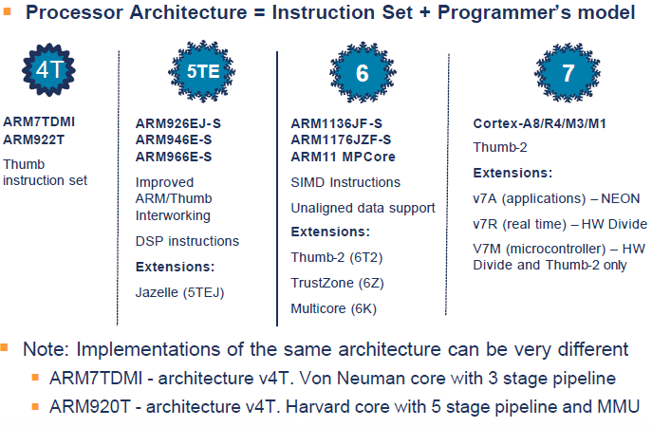
8
Cortex-A53/A58
AArch32/AArch64
Crypto support – AES/SHA

Slide 11
ARM architecture profiles are defined as follows:
  ARMv7-A The application profile (e.g., Cortex-A8)
    For systems supporting the ARM and Thumb instruction sets
    Require virtual address support in the memory management (MMU)model.
  ARMv7-R The real-time profile (e.g., Cortex-R4)
    For systems supporting the ARM and Thumb instruction sets
    Require physical address support only in the memory management model.
  ARMv7-M The microcontroller profile (e.g., Cortex-M4)
    For systems supporting only the Thumb instruction set
    Where overall size and deterministic operation for an implementation are more important than absolute performance.
The instruction sets:
The ARM instruction set is a set of 32-bit instructions providing comprehensive data-processing and control functions.
The Thumb instruction set was developed as a 16-bit instruction set with a subset of the functionality of the ARM instruction set. It provides significantly improved code density, at a cost of some reduction in performance. A processor executing Thumb instructions can change to executing ARM instructions for performance critical segments, in particular for handling interrupts.

Slide 12
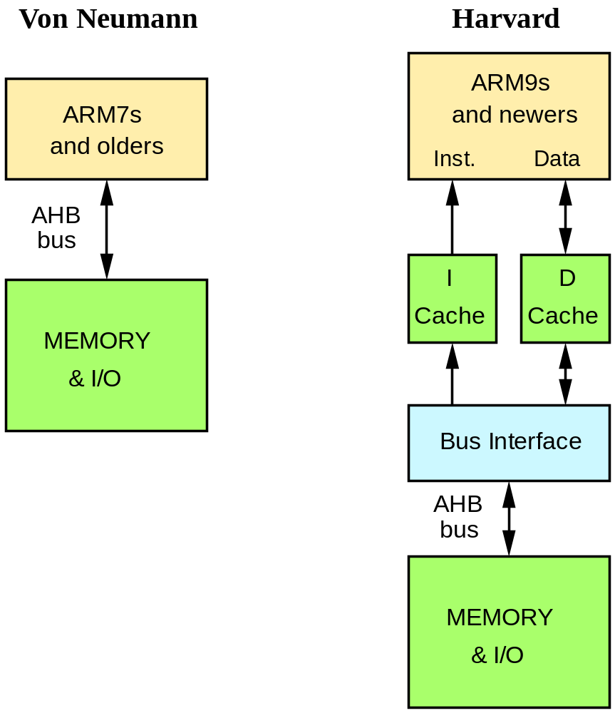
Topologies
Memory-mapped I/O:
  No specific instructions for I/O (use Load/Store instr. instead)
  Peripheral’s registers at some memory addresses

Slide 13
ARM7TDMI
Block Diagram /
Data Flow model
Data Bus(32-bit)
Load
Store
Sign Extend
Control Unit
R0,R1….R15(Registers)
Control Signals
Multiplier
Multiplicand
Accumulator
PC Address of Next Instruction
Barrel Shifter
MAC
ALU
Base index addressing mode
Address Register
Increment
Address Bus(32-bit)

Slide 14
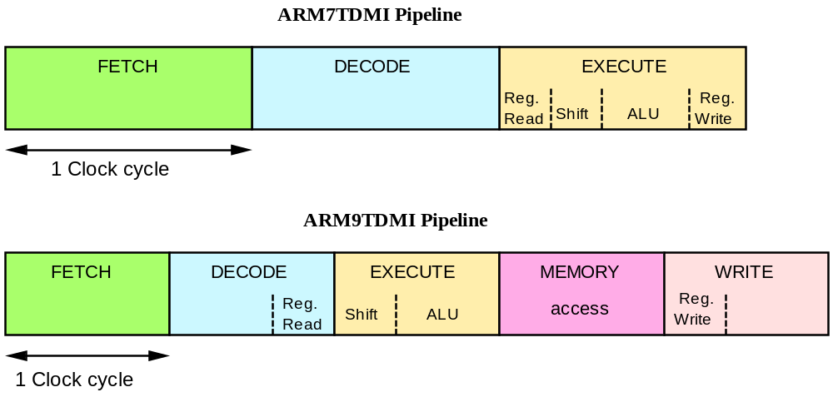
ARM Pipelining examples
Reg.
Decode
Reg.
Decode
Fetch: Read Op-code from memory to internal Instruction Register
Decode: Activate the appropriate control lines depending on Opcode
Execute: Do the actual processing

Slide 15
ARM7TDMI Pipelining (I)
F | D | E | F | D | E | F | D | E | F | D | E | F | D | E
With no pipeline
3x5 = 15 cycles
1
2
3
4
5
F | D | E
 | F | D | E
 |  | F | D | E
 |  |  | F | D | E
 |  |  |  | F | D | E
3x1 + (5 -1) = 7 cycles
K+(n-1) cycles
Simple instructions (like ADD) Complete at a rate of one per cycle

Slide 16
The Registers
ARM has 37 registers all of which are 32-bits long.
  1 dedicated program counter
  1 dedicated current program status register
  5 dedicated saved program status registers
  30 general purpose registers
The current processor mode governs which of several banks is accessible. Each mode can access
  a particular set of r0-r12 registers
  a particular r13 (the stack pointer, sp) and r14 (the link register, lr)
  the program counter, r15 (pc)
  the current program status register, cpsr
Privileged modes (except System) can also access
  a particular spsr (saved program status register)
Notes:
The ARM architecture provides a total of 37 registers, all of which are 32-bits long. However these are arranged into several banks, with the accessible bank being governed by the current processor mode. We will see this in more detail in a couple of slides. In summary though, in each mode, the core can access:
a particular set of 13 general purpose registers (r0 - r12).
a particular r13 - which is typically used as a stack pointer. This will be a different r13 for each mode, so allowing each exception type to have its own stack.
a particular r14 - which is used as a link (or return address) register. Again this will be a different r14 for each mode.
r15 - whose only use is as the Program counter.
The CPSR (Current Program Status Register) - this stores additional information about the state of the processor:
And finally in privileged modes, a particular SPSR (Saved Program Status Register). This stores a copy of the previous CPSR value when an exception occurs. This combined with the link register allows exceptions to return without corrupting processor state.

Slide 17
Special Registers
Special function registers:
  PC (R15): Program Counter. Any instruction with PC as its destination register is a program branch
  LR (R14): Link Register. Saves a copy of PC when executing the BL instruction (subroutine call) or when jumping to an exception or interrupt routine
  - It is copied back to PC on the return from those routines
  SP (R13): Stack Pointer. There is no stack in the ARM architecture. Even so, R13 is usually reserved as a pointer for the program-managed stack
  CPSR : Current Program Status Register. Holds the visible status register
  SPSR : Saved Program Status Register. Holds a copy of the previous status register while executing exception or interrupt routines
  - It is copied back to CPSR on the return from the exception or interrupt
  - No SPSR available in User or System modes

Slide 18
Program Counter (R15)
When the processor is executing in ARM state:
  All instructions are 32 bits wide
  All instructions must be word aligned
  Therefore the PC value is stored in bits [31:2] and bits [1:0] are zero
  Due to pipelining, the PC points 8 bytes ahead of the current instruction, or 12 bytes ahead if current instruction includes a register-specified shift
When the processor is executing in Thumb state:
  All instructions are 16 bits wide
  All instructions must be halfword aligned
  Therefore the PC value is stored in bits [31:1] and bit [0] is zero
Notes:
ARM is designed to efficiently access memory using a single memory access cycle. So word accesses must be on a word address boundary, halfword accesses must be on a halfword address boundary. This includes instruction fetches.
Point out that strictly, the bottom bits of the PC simply do not exist within the ARM core - hence they are ‘undefined’. Memory system must ignore these for instruction fetches.
In Jazelle state, the processor doesn’t perform 8-bit fetches from memory. Instead it does aligned 32-bit fetches (4-byte prefetching) which is more efficient. Note we don’t mention the PC in Jazelle state because the ‘Jazelle PC’ is actually stored in r14 - this is technical detail that is not relevant as it is completely hidden by the Jazelle support code.

Slide 19
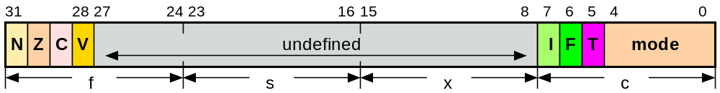
Program Status Registers
Condition code flags
  N = Negative result from ALU
  Z = Zero result from ALU
  C = ALU operation Carried out
  V = ALU operation oVerflowed
Interrupt Disable bits.
  I = 1: Disables the IRQ.
  F = 1: Disables the FIQ.
T Bit (Arch. with Thumb mode only)
  T = 0: Processor in ARM state
  T = 1: Processor in Thumb state
  Never change T directly (use BX instead)
  Changing T in CPSR will lead to unexpected behavior due to pipelining
  Tip: Don’t change undefined bits.
  This allows for code compatibility with newer ARM processors
Mode bits
  10000 User
  10001 FIQ
  10010 IRQ
  10011 Supervisor
  10111 Abort
  11011 Undefined
  11111 System
Notes:
Green psr bits are only in certain versions of the ARM architecture
ALU status flags (set if "S" bit set, implied in Thumb state).
Sticky overflow flag (Q flag) is set either when
saturation occurs during QADD, QDADD, QSUB or QDSUB, or
the result of SMLAxy or SMLAWx overflows 32-bits
Once flag has been set can not be modified by one of the above instructions and must write to CPSR using MSR instruction to cleared
PSRs split into four 8-bit fields that can be individually written:
Control (c) bits 0-7
Extension (x) bits 8-15 Reserved for future use
Status (s) bits 16-23 Reserved for future use
Flags (f) bits 24-31
Bits that are reserved for future use should not be modified by current software. Typically, a read-modify-write strategy should be used to update the value of a status register to ensure future compatibility. Note that the T/J bits in the CPSR should never be changed directly by writing to the PSR (use the BX/BXJ instruction to change state instead).
However, in cases where the processor state is known in advance (e.g. on reset, following an interrupt, or some other exception), an immediate value may be written directly into the status registers, to change only specific bits (e.g. to change mode).
New ARM V6 bits now shown.

Slide 20







Processor Modes
The ARM has seven operating modes:
SVR
On Reset
ABORT
IRQ
SWI
Prefetch / Data Abort
IRQ
USER
FIQ
Undefined
FIQ
Syscall
UND
SYS
Notes:
The Programmers Model can be split into two elements - first of all, the processor modes and secondly, the processor registers. So let’s start by looking at the modes.
Now the typical application will run in an unprivileged mode known as “User” mode, whereas the various exception types will be dealt with in one of the privileged modes : Fast Interrupt, Supervisor, Abort, Normal Interrupt and Undefined
One question here is what is the difference between the privileged and unprivileged modes? Well in reality very little really - the ARM core has an output signal (nTRANS on ARM7TDMI, InTRANS, DnTRANS on 9, or encoded as part of HPROT or BPROT in AMBA) which indicates whether the current mode is privileged or unprivileged, and this can be used, for instance, by a memory controller to only allow IO access in a privileged mode. In addition some operations are only permitted in a privileged mode, such as directly changing the mode and enabling of interrupts.
All current ARM cores implement system mode (added in architecture v4). This is simply a privileged version of user mode. Important for re-entrant exceptions because no exceptions can cause system mode to be entered.

Slide 21
Processor Modes
The ARM has seven operating modes:
  User : unprivileged mode under which most tasks run
  FIQ : entered when a high priority (fast) interrupt is raised
  IRQ : entered when a low priority (normal) interrupt is raised
  SVC : (Supervisor) entered on reset and when a Software Interrupt
  instruction is executed
  Abort : used to handle memory access violations
  Undef : used to handle undefined instructions
  System : privileged mode using the same registers as user mode
Notes:
The Programmers Model can be split into two elements - first of all, the processor modes and secondly, the processor registers. So let’s start by looking at the modes.
Now the typical application will run in an unprivileged mode known as “User” mode, whereas the various exception types will be dealt with in one of the privileged modes : Fast Interrupt, Supervisor, Abort, Normal Interrupt and Undefined
One question here is what is the difference between the privileged and unprivileged modes? Well in reality very little really - the ARM core has an output signal (nTRANS on ARM7TDMI, InTRANS, DnTRANS on 9, or encoded as part of HPROT or BPROT in AMBA) which indicates whether the current mode is privileged or unprivileged, and this can be used, for instance, by a memory controller to only allow IO access in a privileged mode. In addition some operations are only permitted in a privileged mode, such as directly changing the mode and enabling of interrupts.
All current ARM cores implement system mode (added in architecture v4). This is simply a privileged version of user mode. Important for re-entrant exceptions because no exceptions can cause system mode to be entered.

Slide 22
Interrupts / Exceptions
Exception | Mode | Priority | Low Interrupt Vector Address | High Interrupt Vector Address
Reset | Supervisor | 1 | 0x00000000 | 0xFFFF0000
Undefined instruction | Undefined | 6 | 0x00000004 | 0xFFFF0004
Software interrupt | Supervisor | 6 | 0x00000008 | 0xFFFF0008
Prefetch Abort | Abort | 5 | 0x0000000C | 0xFFFF000C
Data Abort | Abort | 2 | 0x00000010 | 0xFFFF0010
 | Reserved |  | 0x00000014 | 0xFFFF0014
Interrupt | IRQ | 4 | 0x00000018 | 0xFFFF0018
Fast interrupt | FIQ | 3 | 0x0000001C | 0xFFFF001C
Table 1 - Exception types, sorted by Interrupt Vector addresses

Slide 23
The ARM Register Set
Current Visible Registers
Current Visible Registers
Current Visible Registers
Current Visible Registers
Current Visible Registers
Current Visible Registers
r0
r0
r0
r0
r0
r0
Abort Mode
r0
SVC Mode
Undef Mode
FIQ Mode
User Mode
IRQ Mode
r1
r1
r1
r1
r1
r1
r1
r2
r2
r2
r2
r2
r2
r2
Banked out Registers
Banked out Registers
Banked out Registers
Banked out Registers
Banked out Registers
r3
Banked out Registers
r3
r3
r3
r3
r3
r3
r4
r4
r4
r4
r4
r4
r4
r5
r5
r5
r5
r5
r5
r5
User,
SYS
User
User
User
User
FIQ
FIQ
FIQ
FIQ
FIQ
FIQ
IRQ
IRQ
IRQ
IRQ
IRQ
IRQ
SVC
SVC
SVC
SVC
SVC
SVC
Undef
Undef
Undef
Undef
Undef
Undef
Abort
Abort
Abort
Abort
Abort
r6
Abort
r6
r6
r6
r6
r6
r6
r7
r7
r7
r7
r7
r7
r7
r8
r8
r8
r8
r8
r8
r8
r8
r8
r8
r8
r8
r8
r8
r9
r9
r9
r9
r9
r9
r9
r9
r9
r9
r9
r9
r9
r9
r10
r10
r10
r10
r10
r10
r10
r10
r10
r10
r10
r10
r10
r10
r11
r11
r11
r11
r11
r11
r11
r11
r11
r11
r11
r11
r11
r11
r12
r12
r12
r12
r12
r12
r12
r12
r12
r12
r12
r12
r12
r12
r13 (sp)
r13 (sp)
r13 (sp)
r13 (sp)
r13 (sp)
r13 (sp)
r13 (sp)
r13 (sp)
r13 (sp)
r13 (sp)
r13 (sp)
r13 (sp)
r13 (sp)
r13 (sp)
r13 (sp)
r13 (sp)
r13 (sp)
r13 (sp)
r13 (sp)
r13 (sp)
r13 (sp)
r13 (sp)
r13 (sp)
r13 (sp)
r13 (sp)
r13 (sp)
r13 (sp)
r13 (sp)
r13 (sp)
r13 (sp)
r13 (sp)
r13 (sp)
r13 (sp)
r13 (sp)
r13 (sp)
r13 (sp)
r13 (sp)
r13 (sp)
r13 (sp)
r13 (sp)
r13 (sp)
r13 (sp)
r14 (lr)
r14 (lr)
r14 (lr)
r14 (lr)
r14 (lr)
r14 (lr)
r14 (lr)
r14 (lr)
r14 (lr)
r14 (lr)
r14 (lr)
r14 (lr)
r14 (lr)
r14 (lr)
r14 (lr)
r14 (lr)
r14 (lr)
r14 (lr)
r14 (lr)
r14 (lr)
r14 (lr)
r14 (lr)
r14 (lr)
r14 (lr)
r14 (lr)
r14 (lr)
r14 (lr)
r14 (lr)
r14 (lr)
r14 (lr)
r14 (lr)
r14 (lr)
r14 (lr)
r14 (lr)
r14 (lr)
r14 (lr)
r14 (lr)
r14 (lr)
r14 (lr)
r14 (lr)
r14 (lr)
r14 (lr)
r15 (pc)
r15 (pc)
r15 (pc)
r15 (pc)
r15 (pc)
r15 (pc)
r15 (pc)
cpsr
cpsr
cpsr
cpsr
cpsr
cpsr
cpsr
spsr
spsr
spsr
spsr
spsr
spsr
spsr
spsr
spsr
spsr
spsr
spsr
spsr
spsr
spsr
spsr
spsr
spsr
spsr
spsr
spsr
spsr
spsr
spsr
spsr
spsr
spsr
spsr
spsr
spsr
spsr
spsr
spsr
spsr
spsr
Notes:
This animated slide shows the way that the banking of registers works. On the left the currently visible set of registers are shown for a particular mode.
On the right are the registers that are banked out whilst in that mode.
Each key press will switch mode:
user -> FIQ ->user -> IRQ -> user ->SVC -> User -> Undef -> User -> Abort and then back to user.
The following slide then shows this in a more static way that is more useful for reference

Slide 24
Register Organization Summary
User,
SYS
FIQ
IRQ
SVC
Undef
Abort
r0
User
mode
r0-r7,
r15,
and
cpsr
User
mode
r0-r12,
r15,
and
cpsr
User
mode
r0-r12,
r15,
and
cpsr
User
mode
r0-r12,
r15,
and
cpsr
User
mode
r0-r12,
r15,
and
cpsr
r1
r2
r3
r4
r5
r6
r7
r8
r8
r9
r9
r10
r10
r11
r11
r12
r12
r13 (sp)
r13 (sp)
r13 (sp)
r13 (sp)
r13 (sp)
r13 (sp)
r14 (lr)
r14 (lr)
r14 (lr)
r14 (lr)
r14 (lr)
r14 (lr)
r15 (pc)
cpsr
spsr
spsr
spsr
spsr
spsr
Note: System mode uses the User mode register set
Notes:
This slide shows the registers visible in each mode - basically in a more static fashion than the previous animated slide that is more useful for reference.
The main point to state here is the splitting of the registers in Thumb state into Low and High registers.
ARM register banking is the minimum necessary for fast handling of overlapping exceptions of different types (e.g. ABORT during SWI during IRQ). For nested exceptions of the same type (e.g. re-entrant interrupts) some additional pushing of registers to the stack is required.

Slide 25
Exception Handling
When an exception occurs, the ARM:
  Copies CPSR into SPSR_<mode>
  Sets appropriate CPSR bits:
    Changes to ARM state
    Changes to related mode
    Disables IRQ
    Disables FIQ (only on fast interrupts)
  Stores the return address in LR_<mode>
  Sets PC to vector address
To return, exception handler needs to:
  Restore CPSR from SPSR_<mode>
  Restore PC from LR_<mode>
This can only be done in ARM state.
0x1C
FIQ
0x18
IRQ
0x14
(Reserved)
0x10
Data Abort
0x0C
Prefetch Abort
0x08
Software Interrupt
0x04
Undefined Instruction
0x00
Reset
Vector Table
Notes:
Exception handling on the ARM is controlled through the use of an area of memory called the vector table. This lives (normally) at the bottom of the memory map from 0x0 to 0x1c. Within this table one word is allocated to each of the various exception types.
This word will contain some form of ARM instruction that should perform a branch. It does not contain an address.
Reset - executed on power on
Undef - when an invalid instruction reaches the execute stage of the pipeline
SWI - when a software interrupt instruction is executed
Prefetch - when an instruction is fetched from memory that is invalid for some reason, if it reaches the execute stage then this exception is taken
Data - if a load/store instruction tries to access an invalid memory location, then this exception is taken
IRQ - normal interrupt
FIQ - fast interrupt
When one of these exceptions is taken, the ARM goes through a low-overhead sequence of actions in order to invoke the appropriate exception handler. The current instruction is always allowed to complete (except in case of Reset).
IRQ is disabled on entry to all exceptions; FIQ is also disabled on entry to Reset and FIQ.

Slide 26
Addressing Mode

Slide 27
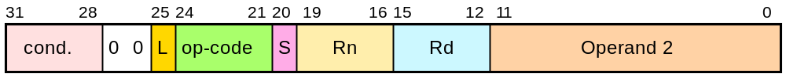
Data processing Instructions
These instructions only work on registers, NOT memory.
L, Literal: 0: Operand 2 from register, 1: Operand 2 immediate
Syntax:
  <Operation>{<cond>}{S} Rd, Rn, Operand2
    {S} means that the Status register is going to be updated
    Comparisons always update the status register. Rd is not specified
    Data movement does not specify Rn
Second operand is sent to the ALU via barrel shifter.
Notes:
BIC bit clear
ORR bit set
AND bit mask
EOR bit invert
Comparisons produce no results - just set condition codes.
CMP like SUB
CMN like ADD (subtract of a negative number is the same as add)
TST like AND
TEQ like EOR (eor of identical numbers gives result of zero)
Generally single-cycle execution (except write to PC and register-controlled shift). Mention ARM NOP & Thumb NOP.
Explain RSB and RSC which do subtract in other order (e.g. y-x not x-y)
Does not include multiply (separate instr format). No divide - compiler uses run-time library or barrel shifter to perform division.
Can combine “S” bit with conditional execution, e.g.
ADDEQS r0, r1, r2

Slide 28
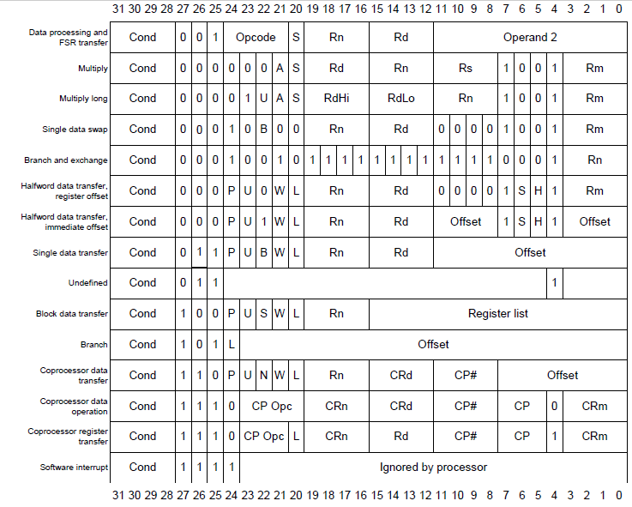
ARM Instruction
Set Formats

Slide 29
Addressing Mode
CISC vs RISC
CISC | RISC
Implied Mode | Immediate Mode
Immediate Mode | Register Mode
Register Mode | Direct Mode
Register Indirect Mode | Indirect Mode
Auto Increment or Auto Decrement | Register Relative Mode
Direct Address Mode | Base Indexed Mode
Indirect Address Mode | Base with Scaled Indexed Mode
Relative Address mode
Index Based Address Mode
Base Register Addressing Mode

Slide 30
Addressing Modes
Immediate MOV R0, #18H ADD R0, R1, #30H Register MOV R0, R1 ADD R0, R1, R2 Direct LDR R0, Address STR R0, Address Indirect LDR R0, [ R1 ] STR R0, [ R1 ] | Register Relative Normal LDR R0, [R1, #02H] Pre Index LDR R0, [R1, #02H] ! Post Index LDR R0, [R1], #02H | 6) Base Indexed Normal LDR R0, [R1, R2] Pre Index LDR R0, [R1, R2] ! Post Index LDR R0, [R1], R2 | Base With Scaled Index Normal LDR R0, [R1, R2, LSL #2] Pre Index LDR R0, [R1,R2, LSL #2] ! Post Index LDR R0, [R1], LSL #2

Slide 31
Instruction Set
Condition Codes:
The 15 possible condition codes are listed below:
    Note AL is the default and does not need to be specified
Suffix
Description
Flags tested
EQ
Equal
Z=1
NE
Not equal
Z=0
CS/HS
Unsigned higher or same
C=1
CC/LO
Unsigned lower
C=0
MI
Minus
N=1
PL
Positive or Zero
N=0
VS
Overflow
V=1
VC
No overflow
V=0
HI
Unsigned higher
C=1 & Z=0
LS
Unsigned lower or same
C=0 or Z=1
GE
Greater or equal
N=V
LT
Less than
N!=V
GT
Greater than
Z=0 & N=V
LE
Less than or equal
Z=1 or N=!V
AL
Always
Notes:
Condition codes are simply a way of testing the ALU status flags.

Slide 32
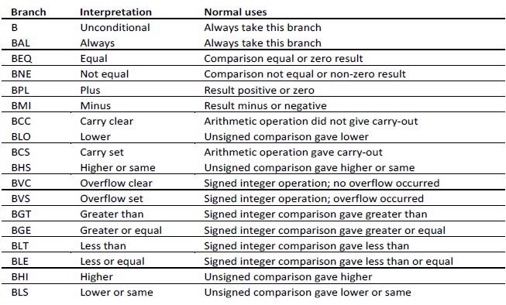

Branch Instructions

Slide 33
Data Movement Instructions
Data xsfer Instructions | LOAD/STORE Instructions8
MOV R0, #15H MOV R0, 0x15 MOV R0, R1 MOVS R0, R1 MOVEQ R0, R1 MOVEQS R0, R1 MVN R0, R1 (R0 ← Not(R1)) | LDR R0, [ R1 ] → 32-bit LDRB R0, [ R1 ] → 8-bit LDRH R0, [ R1 ] → 16-bit LDRSB R0, [ R1 ] → Singed 8-bit LDRSH R0, [ R1 ] → Singed 16-bit LDRT R0, [ R1 ] → Protection from access STR R0, [ R1 ] STRB R0, [ R1 ] STRH R0, [ R1 ] STRSB R0, [ R1 ] STRSH R0, [ R1 ] STRT R0, [ R1 ]
8-bit Immediate Value

Slide 34
Arithmetic Instructions
ADD R0, R1, R2 R0 ← R1 + R2 ADC R0, R1, R2 R0 ← R1 + R2 + CF SUB R0, R1, R2 R0 ← R1 – R2 SBC R0, R1, R2 R0 ← R1 – R2 – NOT(CF) RSB R0, R1, R2 R0 ← R2 – R1 RSC R0, R1,R2 R0 ← R2 – R1 – NOT(CF) | MUL R0, R1, R2 R0 ← R1 * R2 MLA R0, R1, R2, R3 R0 ← R1 * R2 + R3 Long Multiplication UMULL R0, R1, R2, R3 (R1,R0) ← R2 * R3 SMULL R0, R1, R2, R3 (R1,R0) ← R2 * R3 UMLAL R0, R1, R2, R3 (R1,R0) ← R2 * R3 + (R1,R0) SMLAL R0, R1, R2, R3 (R1,R0) ← R2 * R3 + (R1,R0)

Slide 35
Logical Instructions
To update CPSR flag, add S at the end AND R0, R1, R2 R0 ← R1 & R2 ORR R0, R1, R2 R0 ← R1 | R2 EOR R0, R1, R2 R0 ← R1 ^ R2 BIC R0, R1, R2 ➔ Bit Clear R0 ← R1 & NOT(R2) | CPSR gets updated automatically CMP R0, R1 R0 – R1 CMN R0, R1 ➔ Comp Negated R0 + R1 TST R0, R1 R0 & R1 TEQ R0, R1 R0 ^ R1

Slide 36
Stack related Instructions
SP
SP
xx
xx
SP
xx
Full Ascending Full Descending Empty Ascending
STMFA SP!, {R0 – R4} STMFA R13!, {R0 – R4} STMFD R13!, {R0 – R4} STMEA R13!, {R0 – R4} STMED R13!, {R0 – R4} | LDMFA SP!, {R0 – R4} LDMFA R13!, {R0 – R4} LDMFD R13!, {R0 – R4} LDMEA R13!, {R0 – R4} LDMED R13!, {R0 – R4}

Slide 37
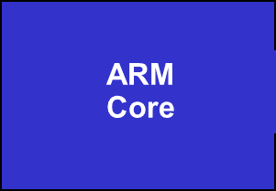
Example ARM-based System
32 bit RAM
Peripherals
16 bit RAM
Interrupt
Controller
I/O
nIRQ
nFIQ
8 bit ROM
Notes:
This slides shows a very generic ARM based design, that is actually fairly representative of the designs that we see being done.
On-chip there will be an ARM core (obviously) together with a number of system dependant peripherals. Also required will be some form of interrupt controller which receives interrupts from the peripherals and raised the IRQ or FIQ input to the ARM as appropriate. This interrupt controller may also provide hardware assistance for prioritizing interrupts.
As far as memory is concerned there is likely to be some (cheap) narrow off-chip ROM (or flash) used to boot the system from. There is also likely to be some 16-bit wide RAM used to store most of the runtime data and perhaps some code copied out of the flash. Then on-chip there may well be some 32-bit memory used to store the interrupt handlers and perhaps stacks.

Slide 38
An Example AMBA System
High Performance
ARM processor
APB
UART
High
Bandwidth
External
Memory
Interface
APB
Bridge
Timer
AHB
Keypad
High-bandwidth
on-chip RAM
DMA
Bus Master
PIO
Low Power
Non-pipelined
Simple Interface
High Performance
Pipelined
Burst Support
Multiple Bus Masters
Notes:
AMBA systems are based around two buses, a high performance system bus and a lower performance peripheral bus.
The high performance bus (AHB) should connect all of the high performance, high bandwidth modules, such as the ARM Processor, any DMA engines, perhaps some fast, 32 bit wide local RAM (or wider to suit the ARM Bus Master being used), an external memory interface, and the interface to the lower performance bus. The number of modules connected here should be kept to a minimum to reduce the bus loading on this high performance bus and allow it to run much faster.
The bulk of the design modules are placed on the lower performance Peripheral Bus (APB). Modules placed here are not accessed as frequently as AHB modules, and as a result of the APB timing, need not consume power (in their APB interfaces) when there is no APB activity. The address and data bus widths on the APB only need to be as wide as required, compared to the AHB where the maximum address and data widths are specified to maximize system performance in this critical area.
So when a design is being partitioned, the main design criteria are
AHB APB
High Performance Low Power
Frequent Access Simple Interface
Pipelined timing Non-pipelined
We don’t go into multi-layer AHB, AHB Lite or any other AMBA configurations in this presentation.

Slide 39
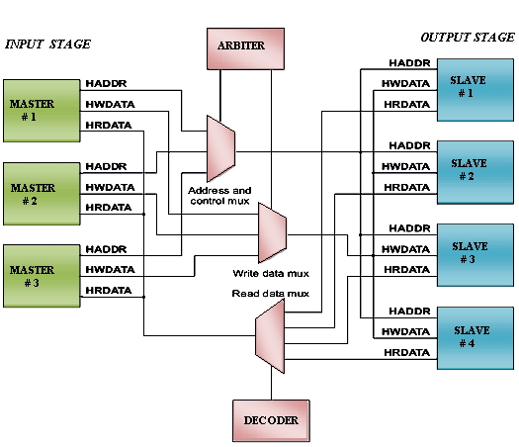
AHB Structure
Centralized Arbiter/Decode
Notes:
AHB is aimed at designers using a central multiplexer interconnection scheme.
All Bus Masters drive out address and control signals for the transfer they wish to perform and the Arbiter decides which access is routed to all the slaves.
A central Decoder is used to select which of the slave data and response signals is fed back to the bus masters.
The central multiplexer solution has been adopted in AHB as the preferred interconnect scheme. However the protocol leaves the final choice up to the designer. As we will see later, the turnaround cycles required for tristate buses have not been optimized out to improve performance. AHB is still therefore suitable for any design flow.

Slide 40
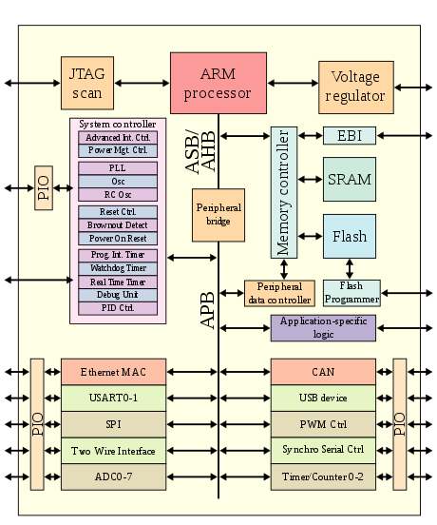
Microprocessor Based SoC

Slide 41
References
https://en.wikipedia.org/wiki/ARM_architecture
https://web.sonoma.edu/users/f/farahman/sonoma/courses/es310/310_arm
https://developer.arm.com/architectures/learn-the-architecture/introducing-the-arm-architecture/single-page

Slide 42
Thank You…

